Slide 1


Integrating React Into Legacy Projects
by Martin Chaov

Slide 2

ES3
ReactJS

Slide 3

Legacy
A gift from the past,
that helps create a better future...
… said no developer ever!

Slide 4

Quite the experience to live in fear, isn’t it?
That’s what it is to depend on legacy code…

Slide 5

"Legacy code" often differs from its suggested alternative by actually working and scaling.
- Bjarne Stroustrup

Slide 6
Legacy project
Any project in use on production
…that’s all

Slide 7

Our software
10+ years on prod
20 000 + live events per month
Millions of users
Monolithic architecture
Custom package manager
On-going feature development
CMS

Slide 8


Slide 9
Some key points
React is fast
Keys are a must
Don’t use ^
Separate the bundles
Top level imports
and more…

Slide 10
Desired solution?

Slide 11
Development
No more monolith
No interfering dev
No back-end
No routing
No authentication
Yes Mocks

Slide 12
Artifacts
Small file size
Shared common logic
Consumed from CDN

Slide 13
Core library
Atomic UI
Helper functions/classes
Package dependencies
…etc.

Slide 14
Quality gates
Linting
Unit testing
Code coverage
NFRs

Slide 15
Configuration package
Separate NPM package
Versioned
Installed
Build
Test
Lint

Slide 16
Interoperability
Abstraction
Common interface
IoC

Slide 17
CI/CD
Click button
Jenkins works
Martin gets more coffee

Slide 18
Architecture overview

Slide 19
React “Block/s” Project
CONFIGS
Block
Parse
Data
Core library
Legacy system

Slide 20
React “Block/s” Project
CONFIGS
Block
Parse
Data
- Legacy integration
- APIs integration
- Dirty logic
- Mocks/Stubs
Core library
Legacy system

Slide 21
React “Block/s” Project
CONFIGS
Block
Parse
- Business logic
- ETL
- CRUD
- Models
Data
Core library
Legacy system

Slide 22
React “Block/s” Project
CONFIGS
Block
- State Store
- UI
Parse
Data
Core library
Legacy system

Slide 23
React “Block” Project
CONFIGS
Block
Parse
Data
React
Comp
State
Store
Integration
Core library
Legacy system

Slide 24
React “Block” Project
CONFIGS
Block
Parse
Data
React
Comp
State
Store
Integration
Core library
Legacy system

Slide 25
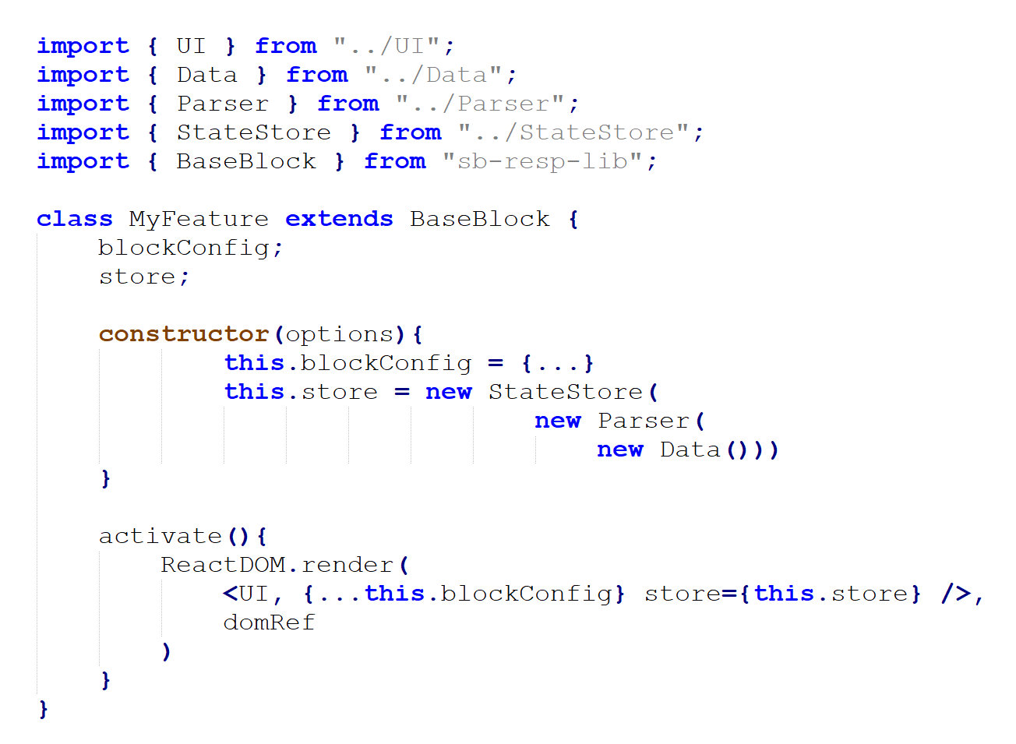

Slide 26
Architecture variations

Slide 27
React “Block” Project
CONFIGS
Block 1
Parse
Data
Block 2
Block 3
…
Core library
Legacy system

Slide 28
React “Block” Project
CONFIGS
Block 1
State
Store
Parse
Data
Block 2
Block 3
…
Core library
Legacy system

Slide 29
React “Block” Project
CONFIGS
Block 1
State
Store
Parse
Data
Block 2
Block 3
…
Core library
Legacy system

Slide 30
Pros
Separation of concerns
Technology agnostic
Code reuse
Resilience

Slide 31
Cons
Harder adoption
Complex initial setup

Slide 32


Slide 33


LinkedIn: https://goo.gl/CRRJ2Y
Mail: martin.c@sbtech.com
Github: https://github.com/mchaov

